Slide 1

Department of Information Technology
NBA Accredited A.P. Shah Institute of Technology G.B.Road, Kasarvadavli, Thane(W), Mumbai-400615 UNIVERSITY OF MUMBAI Academic Year 2022-2023

Slide 2
A Project Report on Developing Chat-Server Support for addressing FAQ’s about creative learning
Submitted in partial fulfillment of the degree of Bachelor of Engineering(Sem-8) in
INFORMATION TECHNOLOGY By Shridhar Joshi (19104034) Akshada Warik (19104042) Harsh Rathod (19104057) Under the Guidance of Prof. Anagha Aher

Slide 3
1.Project Conception and Initiation

Slide 4
1.1 Abstract
Using an analysis bot to scan for inappropriate words and if found, the message will be highlighted and will not be uploaded to the server.
This helps to maintain the quality of chats on popular e-learning platforms.
Decision Tree Classifier will be used for performing classification.

Slide 5
1.2 Objectives
To build a live-chat server using Node, Express.
To create a community forum for educational discussion using HTML5, CSS3 and JS5.
To use “Bag of Words” approach and Decision Tree Classifier to categorize the sentiment of the comments and filter out inappropriate data.
To create a Generative chatbot and train the bot for guiding users.
To provide reliable results by aggregating and extracting valuable information by all the data collected and display it on the dashboard.

Slide 6
1.3 Literature Review
Sr.No | Title | Authors | Methodology & Algorithms | Benefits
1. | People’s Behavior Analysis in Chat Message using Natural Language Processing - 2021 | V.Selina Annie Retna Prof. P. Brundha Dr. RajKumar G | Deep Learning, NLP, Sentiment Analysis,Text Mining | 1.Positive & negative statements by each user 2.Business users can analyze
2. | Real Time Emotion Support System in Text Mining - 2021 | R.S.Ramya Sandhya K K.R.Venugopal | Deep Belief Network, Sentiment Analysis, Text-Mining | 1. Predicting user rating from user comments 2. Saves time as compared to other baseline methods. 3. shows highest accuracy(75.85%)
3. | A Comparative Approach to Naive Bayes Classifier and Support Vector Machine for Email Spam Classification - 2020 | Thae Ma Ma, Kunihito YAMAMORI, Aye Thida | Naive Bayes, SVM, Hidden Markov Model, k nearest neighbor, Neural Networks, | 1.Distinguish between spam and legitimate emails 2.Higher accuracy

Slide 7
1.4 Problem Definition
Many e-learning systems lack a 24-hour chat service where students may ask questions about their courses.
Some users can end up wasting time as a result of this.
Some notorious people may post remarks that might negatively affect other users' learning opportunities or sentiments in a variety of ways.
These offensive comments violate the sites' decorum, cause member conflict, and may have negative effects on the members' mental and emotional well-being.

Slide 8
1.5 Scope
Students can use live chat to get real-time support from teachers or tutors.
Live chat servers can facilitate collaborative learning among students.
Live chat servers can be used in distance education programs to facilitate communication between teachers and students who are located in different parts of the world.
Abuse detection bot is to help create a safe and positive learning environment by detecting and flagging any inappropriate, offensive, or abusive behavior.

Slide 9
1.6 Technology stack
HTML5, CSS3, JS5- Used to create a frontend web application.
Node (16.16.0)- Node.Js is used in the implementation of live-chat server.
Express (4.18.1)- Express is used to build backend API’s.
Python 3 (3.9.2)- Python 3 will be used to implement algorithms for text analysis.

Slide 10
1.7 Benefits for environment & Society
By eliminating the need for face-to-face meetings, live chat servers can help reduce greenhouse gas emissions and air pollution.
Live chat servers can increase accessibility to education and support services for people who may have difficulty attending in-person meetings or events.
Live chat servers can be cost-effective, as they can reduce expenses related to travel, venue rental, and other associated costs.
Abuse detection bots can help reduce the prevalence of cyberbullying and promote respect and create a more conducive learning environment for all students.

Slide 11
2. Project Design

Slide 12
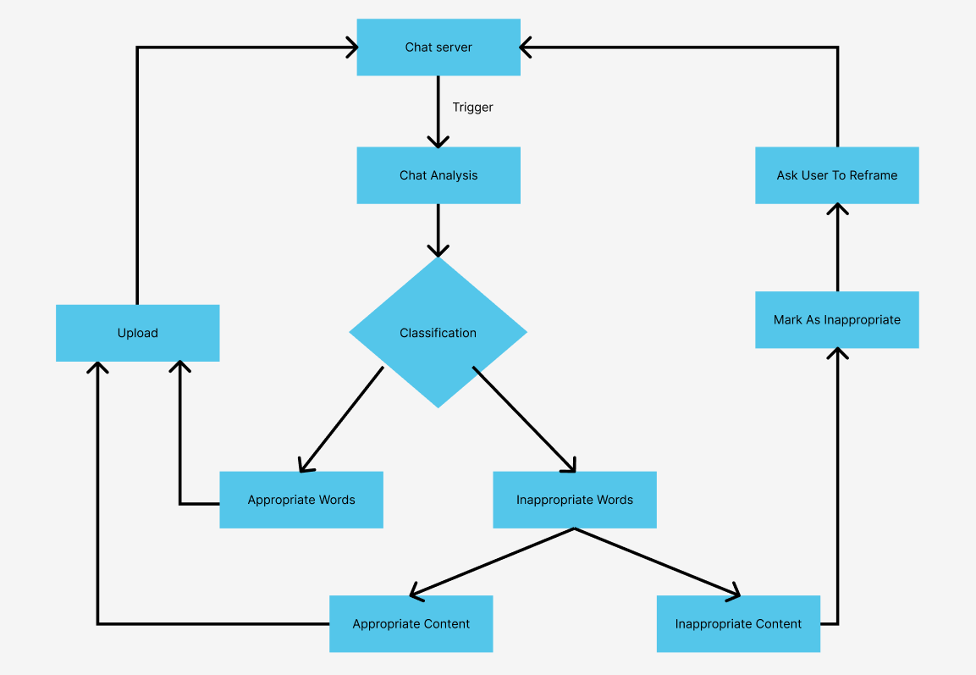
2.1 Proposed System

Slide 13
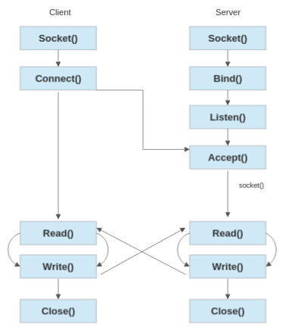
2.2 Workflow Diagram

Slide 14
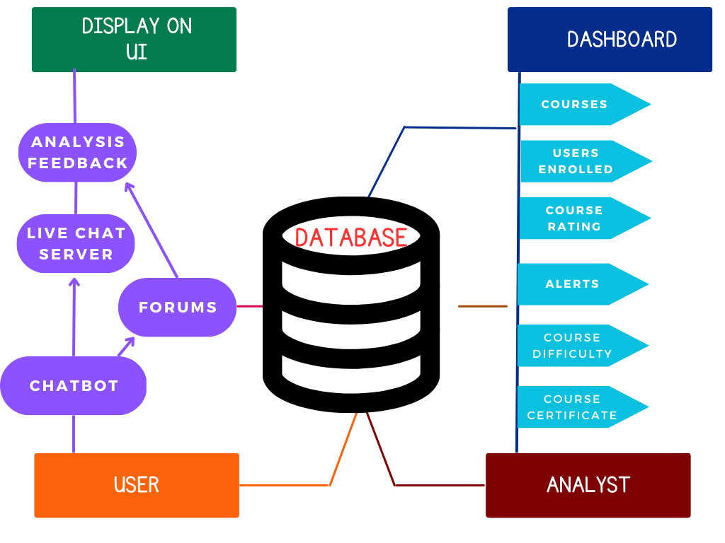
2.3 Use Case Diagram

Slide 15
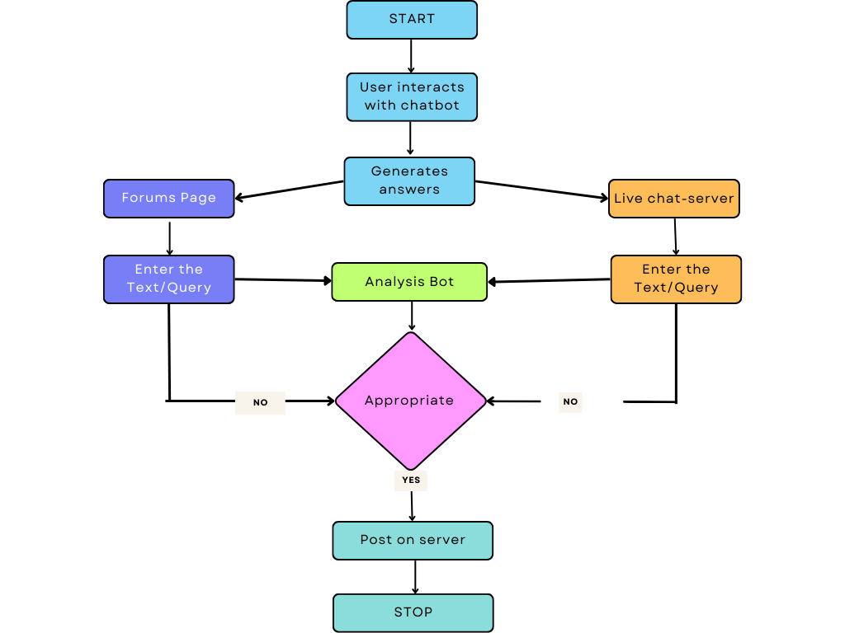
2.4 Activity diagram

Slide 16
3. Implementation

Slide 17
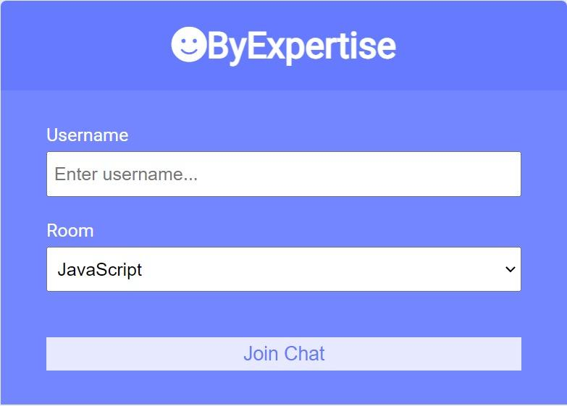
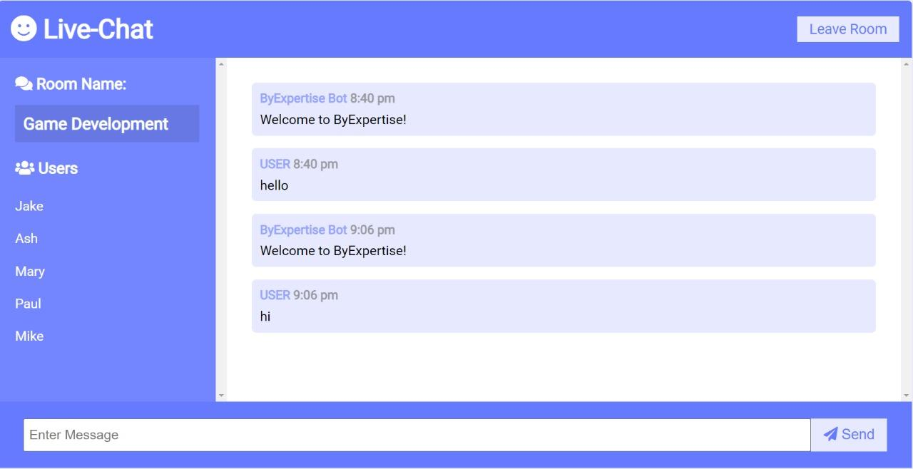
3.1 Live Chat Server
Selection of Chat Room
Entering Live Chat Server

Slide 18
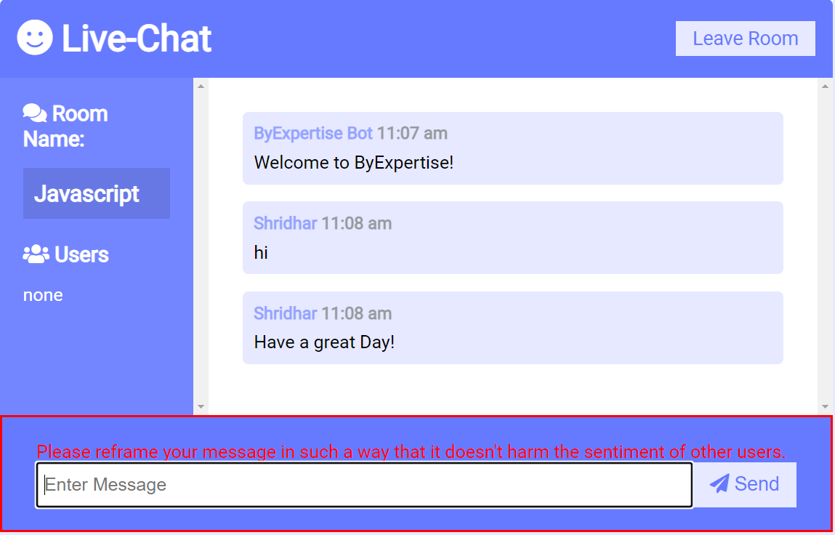
User asked to re-frame in case of an inappropriate message

Slide 19
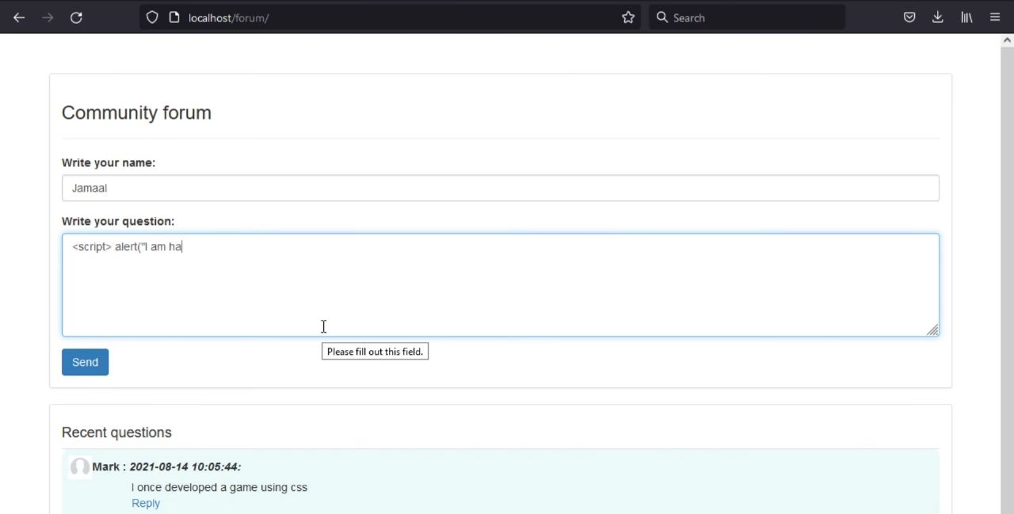
3.2 Community Forums
Use of Forums in educational platforms

Slide 20
4. Testing

Slide 21
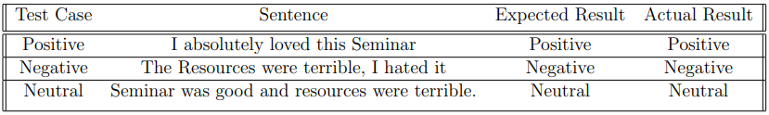
Test Cases

Slide 22
5. Result

Slide 23
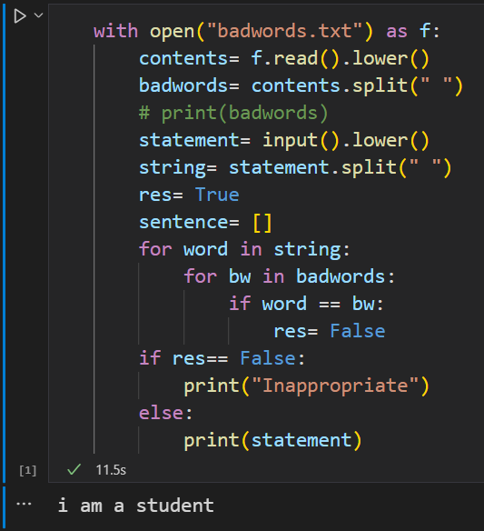
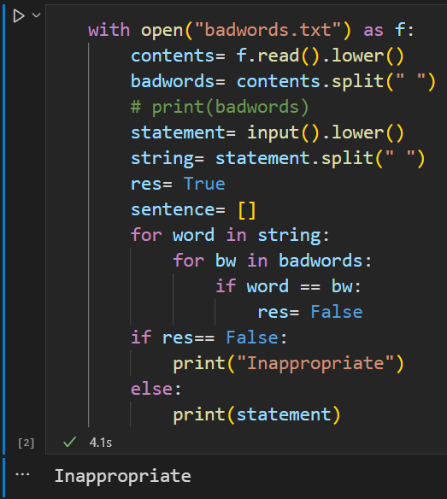
5.1 Analysis Bot
Working of Analysis Bot in case of an Appropriate statement or Inappropriate statement.

Slide 24
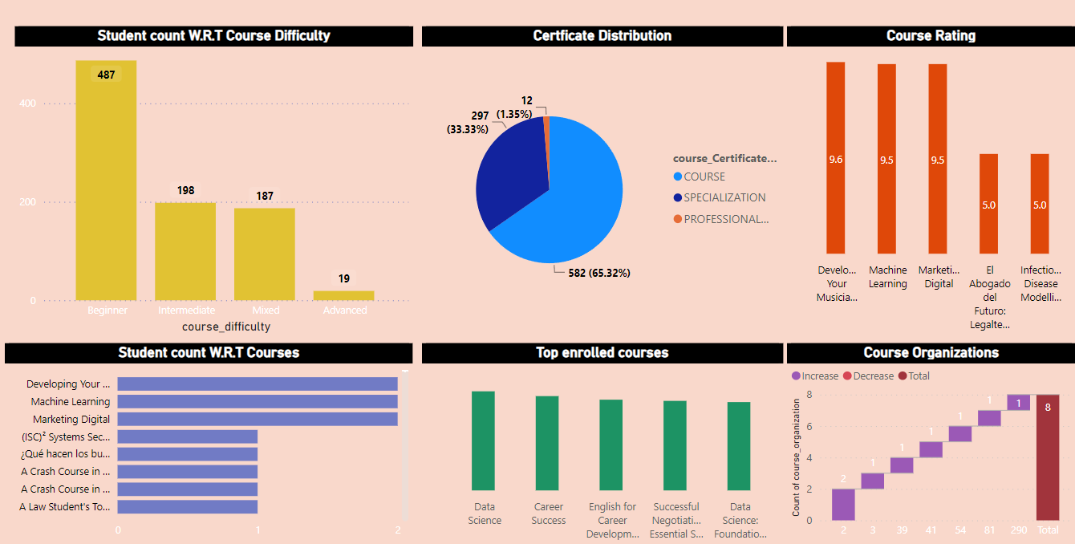
5.2 Analysis Dashboard

Slide 25
6. Conclusion and Future Scope

Slide 26
6.1 Conclusion
The system uses NLP approach to build this educational chat server.
The system which we have developed is an abuse detection bot which helps to identify and minimize offensive contents in online learning platforms.
We have created a generative chatbot that responds automatically, is available constantly, and also saves time by reducing the need for human interaction.

Slide 27
6.2 Future Scope
Live chat servers can be used to integrate virtual and augmented reality technology to provide immersive and interactive chat experiences.
Live chat servers could evolve to include voice and video chat capabilities, enabling users to have more natural and interactive conversations.
Live chat servers could provide multi-language support to cater to a global audience.
The analysis bot should be able to detect and flag abusive content in multiple languages.

Slide 28
Paper Publication
Paper entitled “Developing Chat Server For Addressing FAQ’s about Creative Learning” is accepted at “IC3SEA 2023: International Conference on
Contemporary Challenges in Science and its Engineering Applications” and will be presented by “Shridhar Joshi”.

Slide 29
Thank You

